Slide 1

Addressing & Preventing Attrition at Frito-Lay
Courtesy of DDSAnalytics (Jack Pehlke)
Notes:
Thanks for joining us today, everyone. It's really an honor to speak with you, and I appreciate that you've taken time out of your day to hear what we have to say.
My name is Jack Pehlke and I'm a data scientist with DDSAnalytics.

Slide 2

About us
Helping you develop + retain staff
Data Science and Predictive Analytics
Providing a competitive edge
Notes:
A little bit about us: as an employment consultancy, we are familiar with the reality that now more than ever there is a large gap in expectations between employers and employees. Our mission is to help bridge that gap in order to help you develop + retain your staff for the long-term. We rely on data science and predictive analytics to generate those insights and provide you a competitive edge.

Slide 3

Attrition
PROBLEM
Culture
Costs
Quality
SOLUTION
Identify
Predict
Implement
?
Notes:
With attrition, there are wide-ranging impacts to a business. It can create negative attitudes and diminish a thriving culture. It can lead to increased recruitment and training costs. It can impact product quality and interruptions in regular workflow.
We're here to help identify those leading causes of attrition. Then we can use those to predict sections of employees that might be likely to leave, which will empower you to implement change and retain your staff long-term.

Slide 4
Identify
Which of these correlated to the highest rates of attrition?
Age
Daily Rate
Distance From Home
Education
Employee Number
Environment Satisfaction
Hourly Rate
Job Involvement
Job Level
Job Satisfaction
Marital Status
Monthly Income
Monthly Rate
Number of Companies Worked
Percent Salary Hike
Performance Rating
Relationship Satisfaction
Stock Option Level
Total Working Years
Training Times Last Year
Work Life Balance
Years At Company
Years In Current Role
Years Since Last Promotion
Years With Current Manager
Notes:
With the data we've been provided, we'll be able to look at some of these factors that correlate with the highest rates of attrition. Looking through relationship satisfaction, percent salary hike, number of companies worked – I'm sure we can all draw valuable insights based on our previous experience in the workforce. Thankfully, we have detailed information to pair with those factors in order to identify the top 3 factors leading to attrition.

Slide 5
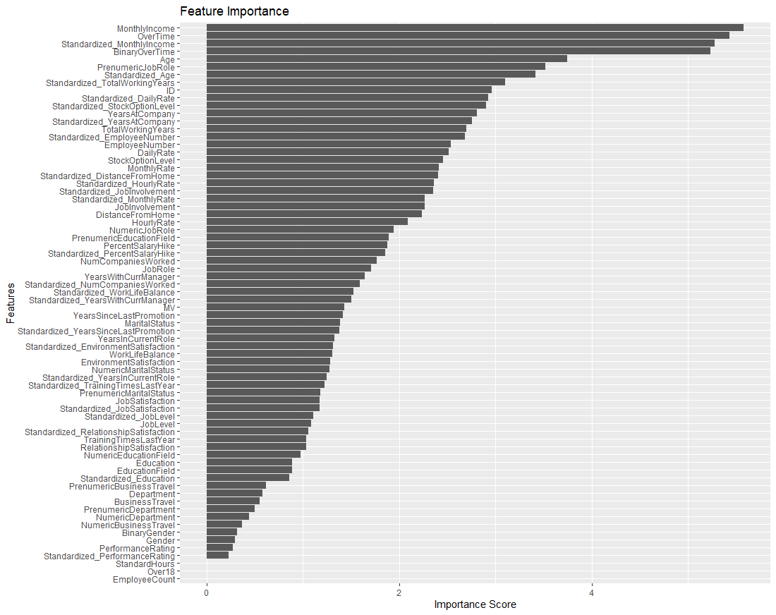
Random Forest & Feature Importance
Monthly Income
Overtime
Age
Notes:
This is a random forest model that we've utilized on the data to classify the most important features as it relates to attrition. At the top, you can see Monthly Income, Overtime, and Age (below those related datapoints for overtime and monthly income).

Slide 6
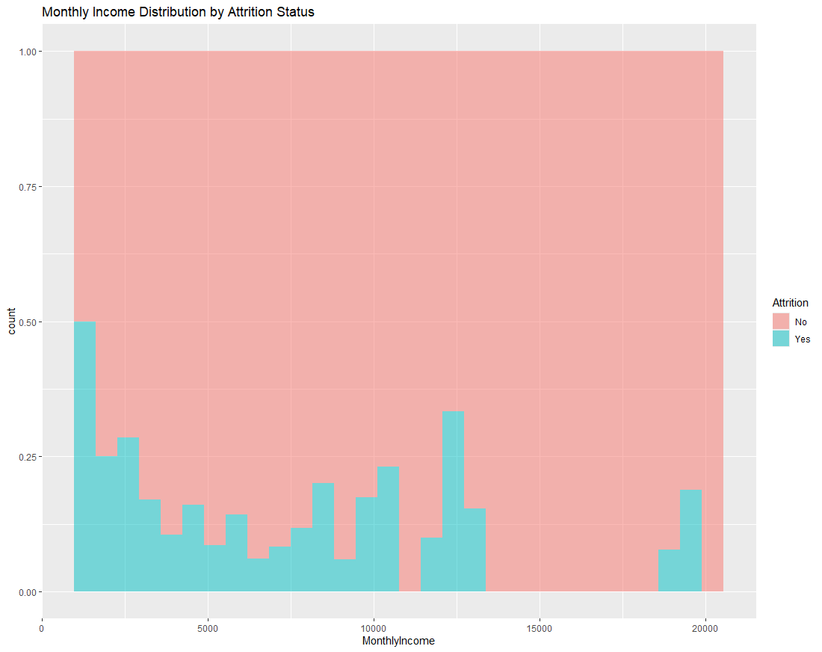
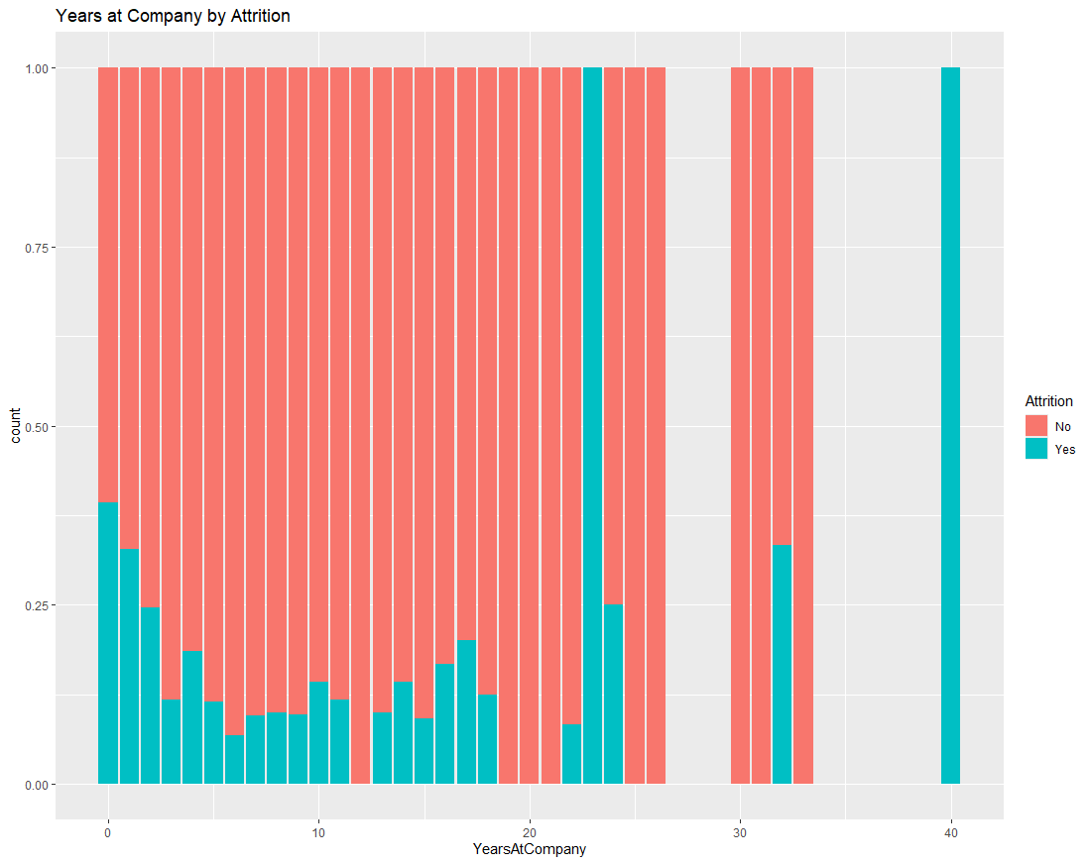
Monthly Income vs. Attrition
Notes:
Looking at the data between monthly income and attrition, we can see a higher rate of attrition at those entry level salaries. There's another spike at that 125k mark and then a large gap before we see anyone else leave. Intuitively, this makes sense. Money talks in the job market and once people gain some experience, they might be liable to move to a new organization.
I wanted to pull up information on the years at the company next to this, since entry level roles are on our mind. We can see a somewhat similar pattern, although our data jumps sporadically given a smaller number of employees a that tenure.

Slide 7
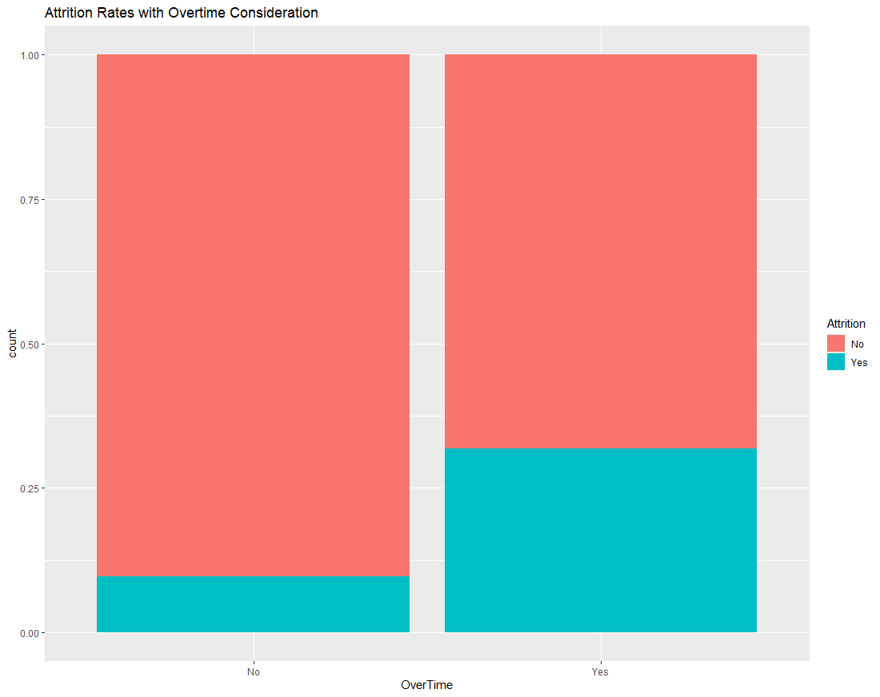
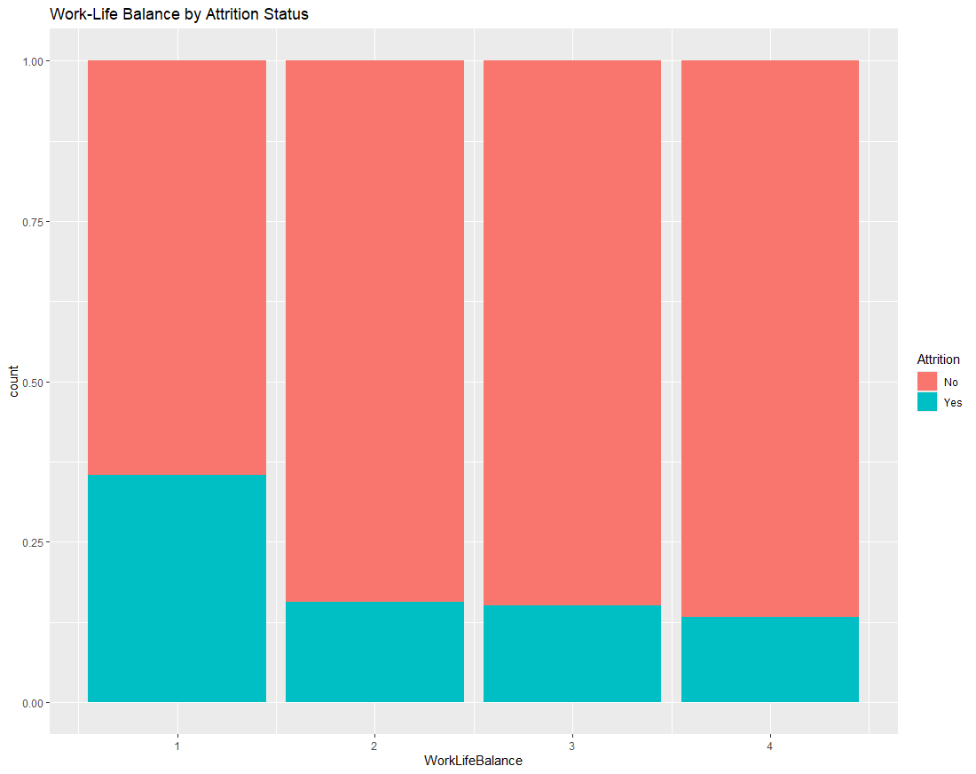
Overtime vs. Attrition
Notes:
Overtime clearly demonstrates a large impact on attrition. We see well over double the rate of attrition with those who have to work overtime vs those that do not.
Worklife balance is frequently mentioned with disgruntled employees, and we can see that those who marked the lowest work life balance had signficantly higher rates of attrition as well.

Slide 8
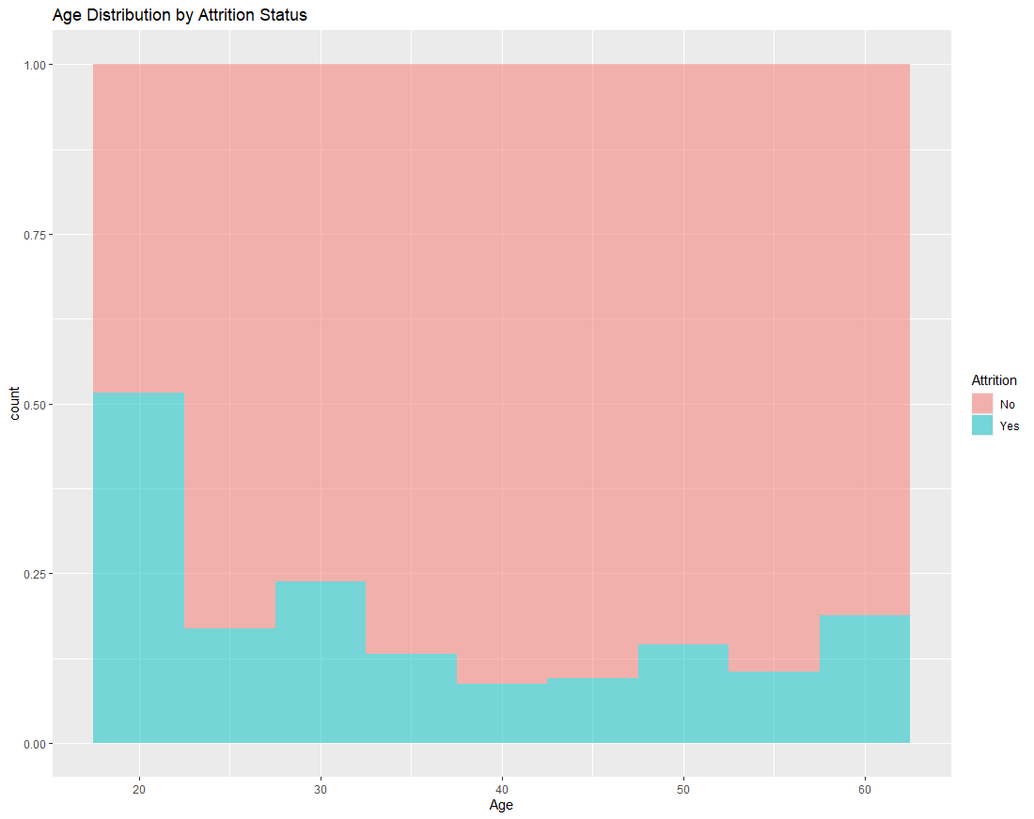
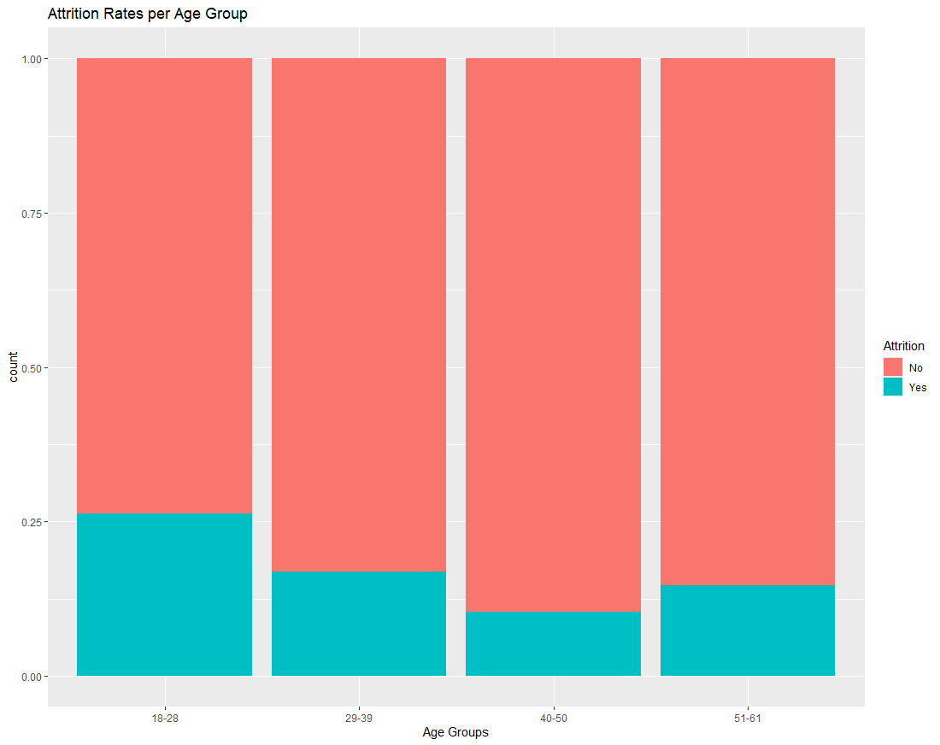
Age vs. Attrition
Notes:
Age was our final metric from the Random Forest model, and we can see that generally, those younger employees are the ones leaving. This is common from what we've seen in the market and goes in hand with those lower salary figures for entry level employees.

Slide 9
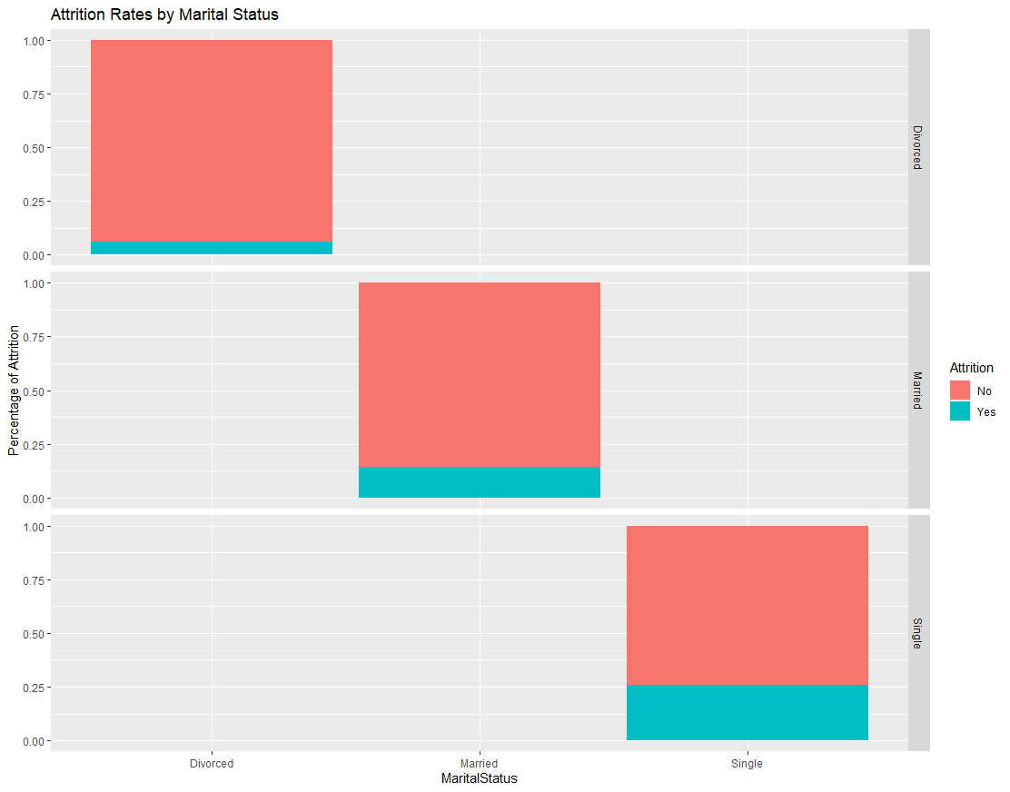
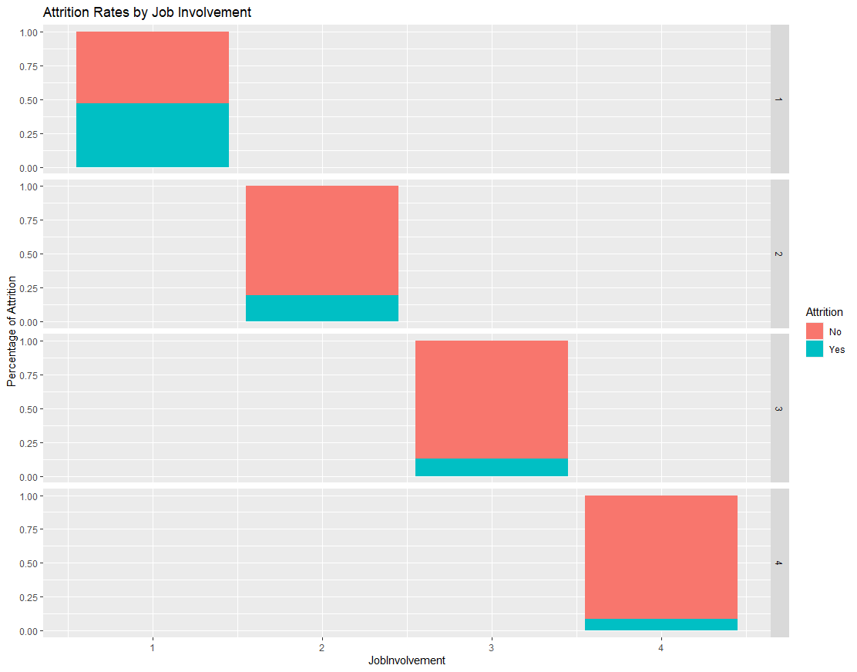
Marital Status + Job Involvement
Notes:
In our data visualization, we also noticed a large spike with marital status and job involvement – the lower score being how involved or engaged someone was in their position. Clearly, at the lowest score we saw a large spike in people leaving as well.

Slide 10
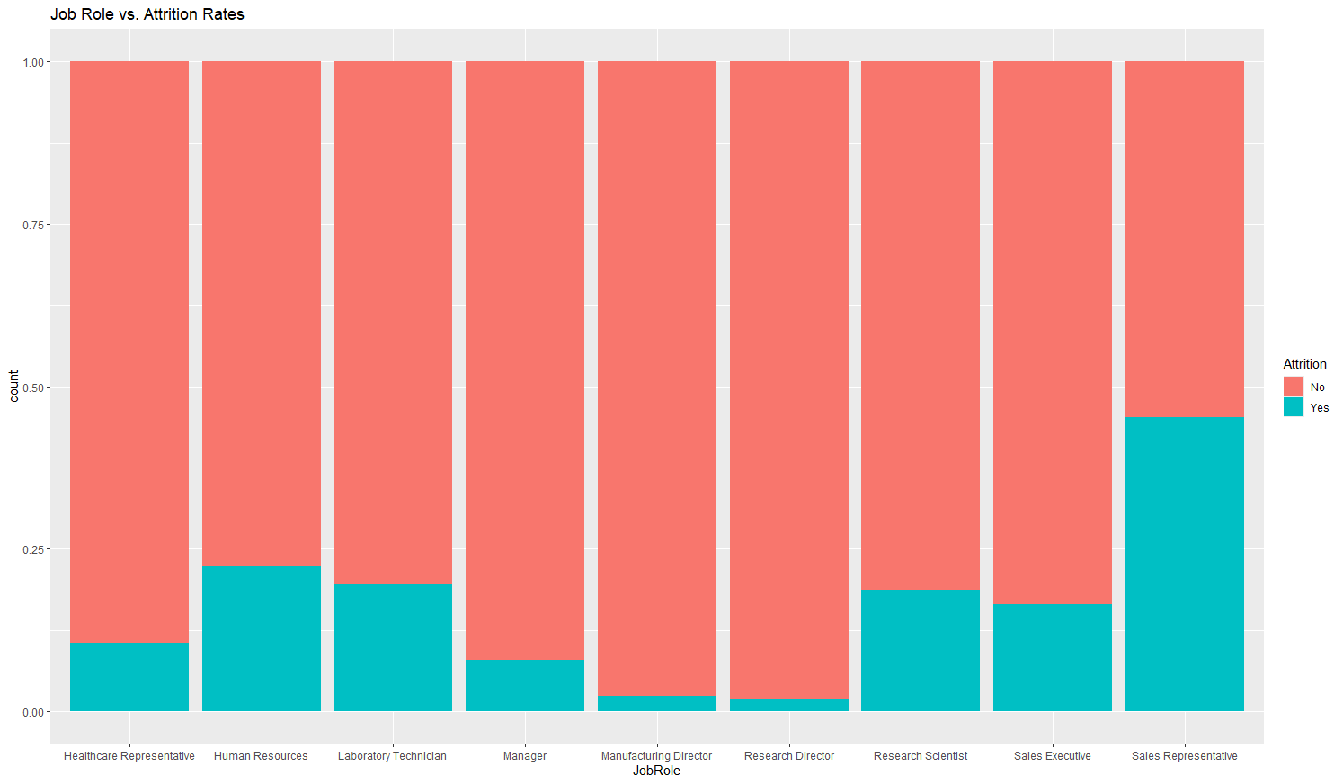
Job Role Trends
Notes:
Looking at individual job roles, we saw the highest rate of attrition with Sales Representatives, followed by HR, research scientists and laboratory technicians.

Slide 11
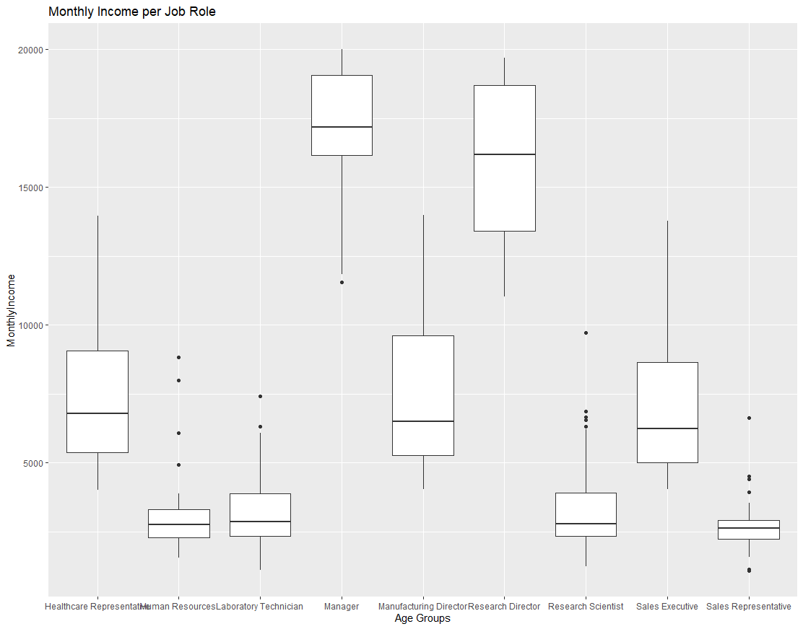
Job Role Trends
Notes:
Looking at Monthly Income again, we see that those 4 job roles had the lowest median salaries. Sales reps are boasting the lowest value for salary here too.

Slide 12
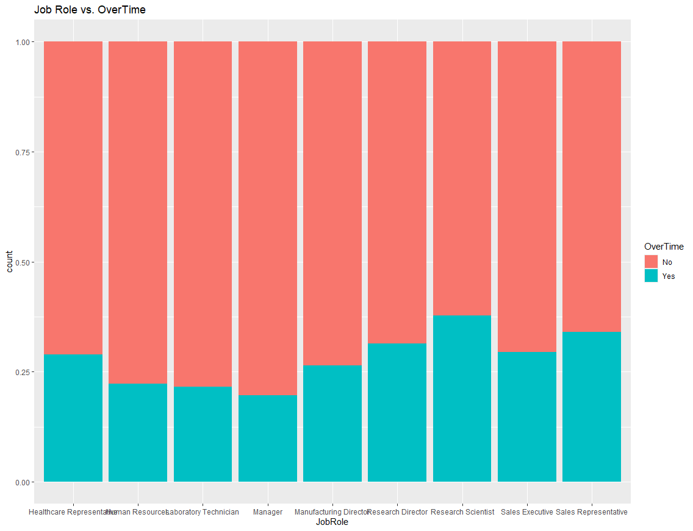
Job Role Trends
Notes:
It seems like overtime is somewhat steady at Frito-Lay, but research scientists topped the charts here, followed by a more senior Director level position and the sales representatives.

Slide 13
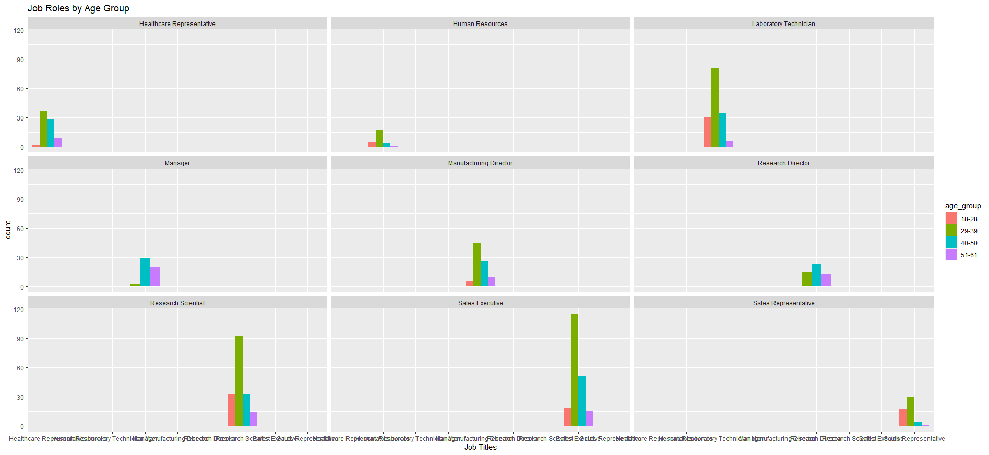
Job Role Trends
Notes:
Here we can see our age demographics per position. Generally, it seems like each department is made up of folks in their 30's to 40's. However – we can see that lab techs and research scientists are dominated by people generally in their 30's.

Slide 14
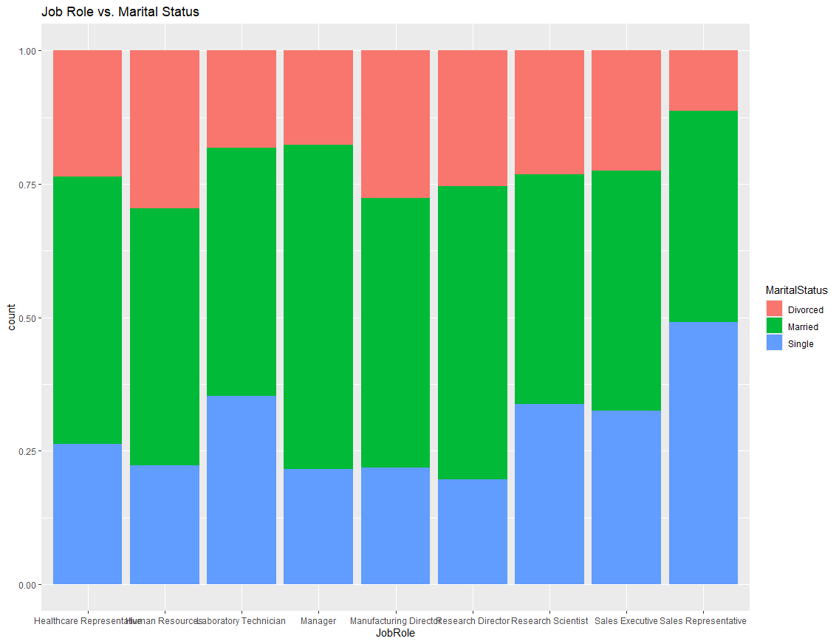
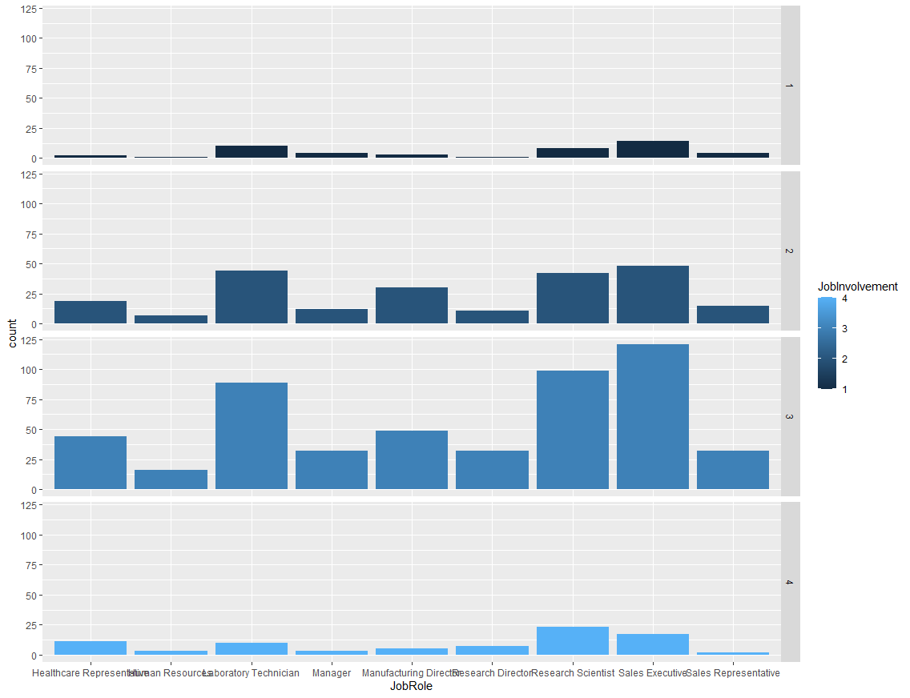
Job Role Trends
Notes:
Looking back at marital status and job involvement, we see that sales representatives were most frequently single. Lab techs and research scientists followed our sales reps there as well.
Generally each department felt involved between a level of 2 or 3.

Slide 15
Identify
Which of these correlated to the highest rates of attrition?
Age
Daily Rate
Distance From Home
Education
Employee Number
Environment Satisfaction
Hourly Rate
Job Involvement
Job Level
Job Satisfaction
Marital Status
Monthly Income
Monthly Rate
Number of Companies Worked
Overtime
Percent Salary Hike
Performance Rating
Relationship Satisfaction
Stock Option Level
Total Working Years
Training Times Last Year
Work Life Balance
Years At Company
Years In Current Role
Years Since Last Promotion
Years With Current Manager
Notes:
Looking through the data, it matches our random forest model pretty well. We can see higher levels of attrition consistently with age, monthly income, and overtime statuses. In the visualization efforts, we noted trends with marital status and job involvement as well.

Slide 16

Naive Bayes Model
Accuracy
83.33%
Sensitivity
87.26%
Specificity
62.86%
Confusion Matrix | Predicted No | Predicted Yes
Actual No | 637 | 52
Actual Yes | 93 | 88
16
Notes:
We constructed a naïve bayes model, which is a statistical model used to predict a variable based on a set of training data. We were able to correctly predict attrition at a rate of 83%. Our sensitivity looks at those we accurately predicted to stay, which was at a rate of 87%. Our specificity was a bit lower at 62%, which is our accurately predicted attrition against our total predicted attrition. Generally we think this is a reliable model and along with our previous insights, can help Frito-Lay identify some of those factors leading to attrition.

Slide 17
Thank You
DDSAnalytics
555-555-0146
dds@DDSA.com
www.ddsa.com

